Slide 1
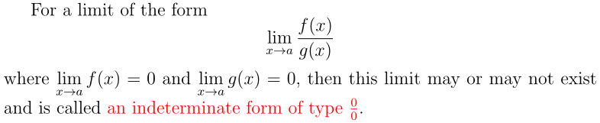

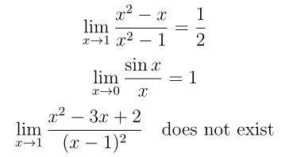

Section 4.5 The L’Hospital’s Rule

Slide 2
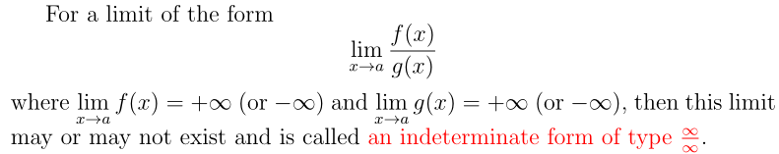
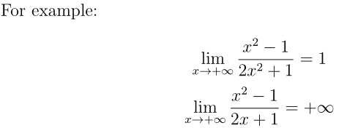


Slide 3
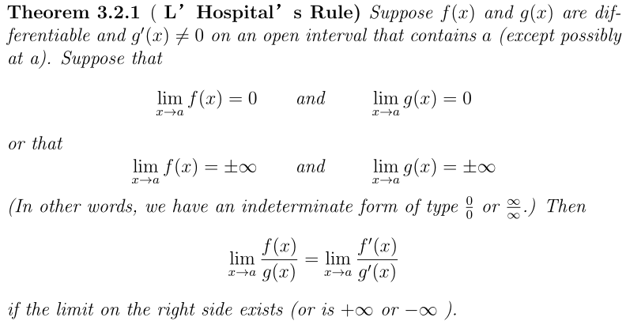

Slide 4
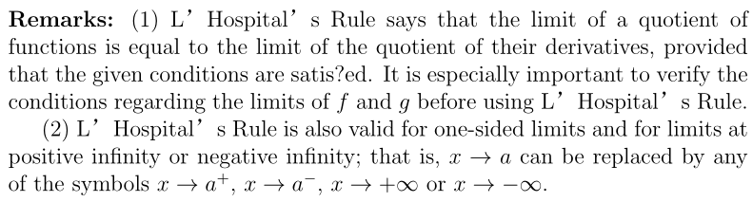
(3) As soon as one or the other of these derivatives is different from zero at we stop differentiating. L’Hôpital’s Rule does not apply when either the numerator or denominator has a finite nonzero limit.

Slide 5




Example 1. Find the following limits

Slide 6
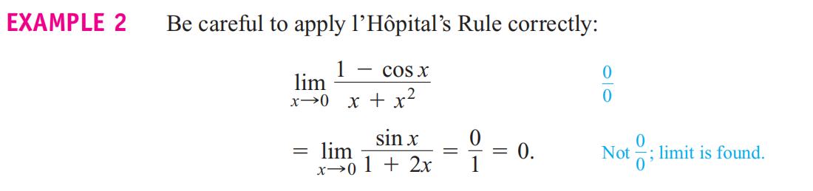

Slide 7



Example 3.
(c)

Slide 8
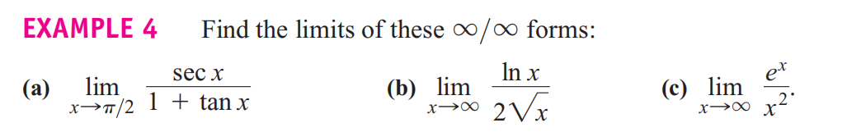

Slide 9


Slide 10
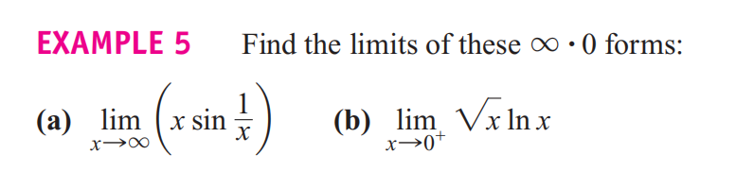

Slide 11
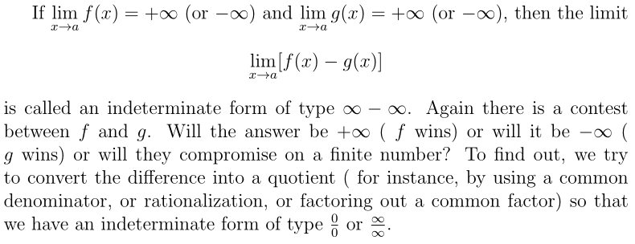

Slide 12

Example 6.

Slide 13
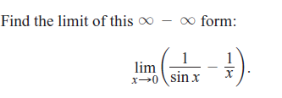
Example 7.

Slide 14

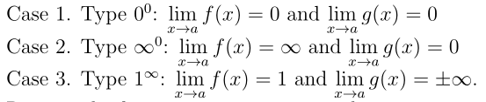


Slide 15
Example 8.

Slide 16

Example 9.

Slide 17

Example 10.

Slide 18





Homework1: Find the following limits

Slide 19
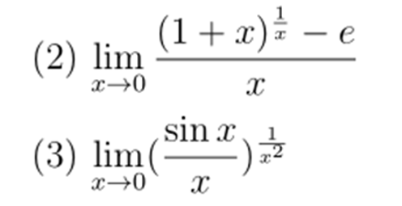
Homework 1: Find the following limits
Homework 2: P261: 16, 41, 53

